Slide 1

Introduction to R
Brody Sandel

Slide 2
The structure of R
Objects (what “things” do you have?)
Functions (what do you want to do to them?)
Control elements (when/how often do you want to do it?)

Slide 3
What is an object?
What size is it?
Vector (one-dimensional, including length = 1)
Matrix (two-dimensional)
Array (n-dimensional)
What does it hold?
Numeric (0, 0.2, Inf, NA)
Logical (T, F)
Factor (“Male”, “Female”)
Character (“Bromus diandrus”, “Bromus carinatus”, “Bison bison”)
Mixtures
Lists
Dataframes
class() is a function that tells you what type of object the argument is

Slide 4
Creating a numeric object
a = 10
a
[1] 10
a <- 10
a
[1] 10
10 -> a
a
[1] 10

Slide 5
Creating a numeric object
a = 10
a
[1] 10
a <- 10
a
[1] 10
10 -> a
a
[1] 10
All of these are assignments

Slide 6
Creating a numeric object
a = a + 1
a
[1] 11
b = a * a
b
[1] 121
x = sqrt(b)
x
[1] 11

Slide 7
Creating a numeric object (length >1)
a = c(4,2,5,10)
a
[1] 4 2 5 10
a = 1:4
a
[1] 1 2 3 4
a = seq(1,10)
a
[1] 1 2 3 4 5 6 7 8 9 10

Slide 8
Creating a numeric object (length >1)
a = c(4,2,5,10)
a
[1] 4 2 5 10
a = 1:4
a
[1] 1 2 3 4
a = seq(1,10)
a
[1] 1 2 3 4 5 6 7 8 9 10
Two arguments passed to this function!

Slide 9
Creating a numeric object (length >1)
a = c(4,2,5,10)
a
[1] 4 2 5 10
a = 1:4
a
[1] 1 2 3 4
a = seq(1,10)
a
[1] 1 2 3 4 5 6 7 8 9 10
This function returns a vector

Slide 10
Creating a matrix object
A = matrix(data = 0, nrow = 6, ncol = 5)
A
[,1] [,2] [,3] [,4] [,5]
[1,] 0 0 0 0 0
[2,] 0 0 0 0 0
[3,] 0 0 0 0 0
[4,] 0 0 0 0 0
[5,] 0 0 0 0 0
[6,] 0 0 0 0 0

Slide 11
Creating a logical object
3 < 5
[1] TRUE
3 > 5
[1] FALSE
x = 5
x == 5
[1] TRUE
x != 5
[1] FALSE
Conditional operators
< > <= >= == != %in% & |

Slide 12
Creating a logical object
3 < 5
[1] TRUE
3 > 5
[1] FALSE
x = 5
x == 5
[1] TRUE
x != 5
[1] FALSE
Very important to remember this difference!!!
Conditional operators
< > <= >= == != %in% & |

Slide 13
Creating a logical object
x = 1:10 x < 5
[1] TRUE TRUE TRUE TRUE FALSE
[6] FALSE FALSE FALSE FALSE FALSE
x == 2
[1] FALSE TRUE FALSE FALSE FALSE
[6] FALSE FALSE FALSE FALSE FALSE
Conditional operators
< > <= >= == != %in% & |

Slide 14
Getting at values
R uses [ ] to refer to elements of objects
For example:
V[5] returns the 5th element of a vector called V
M[2,3] returns the element in the 2nd row, 3rd column of matrix M
M[2,] returns all elements in the 2nd row of matrix M
The number inside the brackets is called an index

Slide 15
Indexing a 1-D object
a = c(3,2,7,8)
a[3]
[1] 7
a[1:3]
[1] 3 2 7
a[seq(2,4)]
[1] 2 7 8

Slide 16
Indexing a 1-D object
a = c(3,2,7,8)
a[3]
[1] 7
a[1:3]
[1] 3 2 7
a[seq(2,4)]
[1] 2 7 8
See what I did there?

Slide 17
Just for fun . . .
a = c(3,2,7,8)
a[a]

Slide 18
Just for fun . . .
a = c(3,2,7,8)
a[a]
[1] 7 2 NA NA
When would a[a] return a?

Slide 19
Indexing a 2-D object
A = matrix(data = 0, nrow = 6, ncol = 5)
A
[,1] [,2] [,3] [,4] [,5]
[1,] 0 0 0 0 0
[2,] 0 0 0 0 0
[3,] 0 0 0 0 0
[4,] 0 0 0 0 0
[5,] 0 0 0 0 0
[6,] 0 0 0 0 0
A[3,4]
[1] 0
The order is always [row, column]

Slide 20
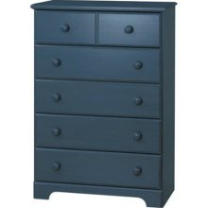
Lists
A list is a generic holder of other variable types
Each element of a list can be anything (even another list!)
a = c(1,2,3)
b = c(10,20,30)
L = list(a,b)
L
[[1]]
[1] 1 2 3
[[2]]
[3] 10 20 30
L[[1]]
[1] 1 2 3
L[[2]][2]
[1] 20

Slide 21
Data and data frames
Principles
Read data off of hard drive
R stores it as an object (saved in your computer’s memory)
Treat that object like any other
Changes to the object are restricted to the object, they don’t affect the data on the hard drive
Data frames are 2-d objects where each column can have a different class

Slide 22
Working directory
The directory where R looks for files, or writes files
setwd() changes it
dir() shows the contents of it
setwd(“C:/Project Directory/”)
dir()
[1] “a figure.pdf”
[2] “more data.csv”
[3] “some data.csv”

Slide 23
Read a data file
setwd(“C:/Project Directory/”)
dir()
[1] “a figure.pdf”
[2] “more data.csv”
[3] “some data.csv”
myData = read.csv(“some data.csv”)

Slide 24
Writing a data file
setwd(“C:/Project Directory/”)
dir()
[1] “a figure.pdf”
[2] “more data.csv”
[3] “some data.csv”
myData = read.csv(“some data.csv”)
write.csv(myData,”updated data.csv”)
dir()
[1] “a figure.pdf”
[2] “more data.csv”
[3] “some data.csv”
[4] “updated data.csv”

Slide 25
Finding your way around a data frame
head() shows the first few lines
tail() shows the last few
names() gives the column names
Pulling out columns
Data$columnname
Data[,columnname]
Data[,3] (if columnname is the 3rd column)

Slide 26
Functions
Function
Object
Object

Slide 27
Functions
Object
Function
Object
Object
Object

Slide 28
Functions
Object
Function
Object
Object
Object
Options

Slide 29
Functions
Object
Function
Object
Object
Return
Object
Options
Arguments

Slide 30
Functions
Object
Function
Object
Object
Object
Options
Controlled by control elements (for, while, if)

Slide 31
Calling a function
Call: a function with a particular set of arguments
function( argument, argument . . . )
x = function( argument, argument . . .)
sqrt(16)
[1] 4
x = sqrt(16)
x
[1] 4

Slide 32
Calling a function
Call: a function with a particular set of arguments
function( argument, argument . . . )
x = function( argument, argument . . .)
sqrt(16)
[1] 4
x = sqrt(16)
x
[1] 4
The function return is not saved, just printed to the screen

Slide 33
Calling a function
Call: a function with a particular set of arguments
function( argument, argument . . . )
x = function( argument, argument . . .)
sqrt(16)
[1] 4
x = sqrt(16)
x
[1] 4
The function return is assigned to a new object, “x”

Slide 34
Arguments to a function
function( argument, argument . . .)
Many functions will have default values for arguments
If unspecified, the argument will take that value
To find these values and a list of all arguments, do:
If you are just looking for functions related to a word, I would use google. But you can also:
?function.name
??key.word

Slide 35
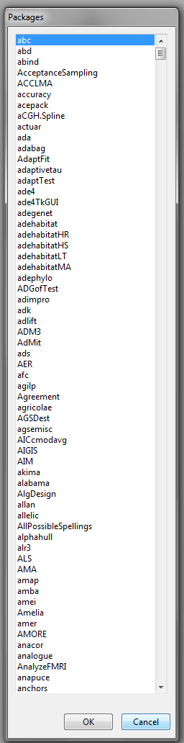
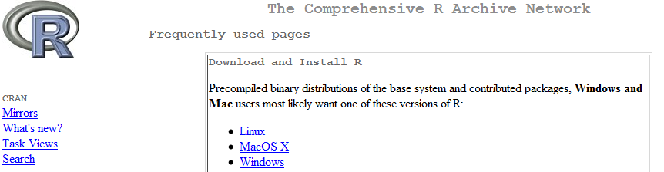
Packages
Sets of functions for a particular purpose
We will explore some of these in detail
install.packages()
require(package.name)
CRAN!

Slide 36
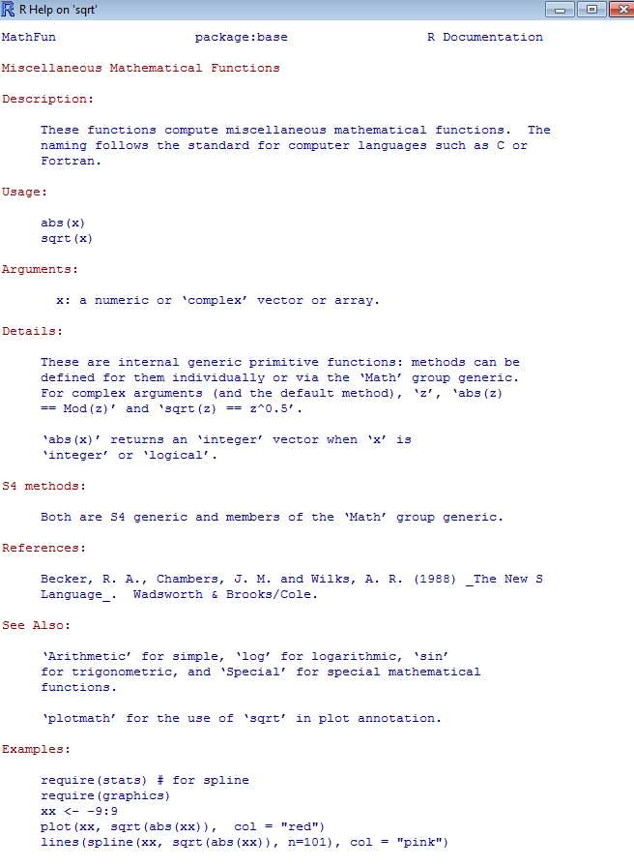
Function help
Syntax
Arguments
Return

Slide 37
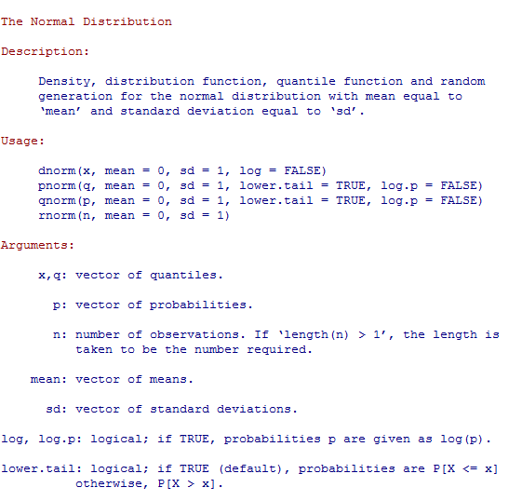
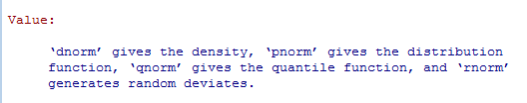
Function help

Slide 38
Programming in R
Functions
Loop

Slide 39
Programming in R
Functions
Loop
Functions
if
Output
Functions
Output
if
Output

Slide 40
Next topic: control elements
for
if
while
The general syntax is:
for/if/while ( conditions )
{
commands
}

Slide 41
For
When you want to do something a certain number of times
When you want to do something to each element of a vector, list, matrix . . .
X = seq(1,4,by = 1)
for(i in X)
{
print(i+1)
}
[1] 2
[1] 3
[1] 4
[1] 5

Slide 42
Details of for
for( i in 1:10 )

Slide 43
Details of for
for( i in 1:10 )
1
2
3
4
5
6
7
8
9
10

Slide 44
Details of for
for( i in 1:10 )
1
2
3
4
5
6
7
8
9
10
i = 1
Do any number of functions with i
print(i)
x = sqrt(i)

Slide 45
Details of for
for( i in 1:10 )
1
2
3
4
5
6
7
8
9
10
i = 2
Do any number of functions with i
print(i)
x = sqrt(i)

Slide 46
Details of for
for( i in 1:10 )
1
2
3
4
5
6
7
8
9
10
i = 10
Do any number of functions with i
print(i)
x = sqrt(i)

Slide 47
i as an Index
X = c(17,3,-1,10,9) Y = rep(NA,5)
for(i in 1:length(X))
{
if(X[i] < 12)
{
Y[i] = X[i] + 5
}
}
X =
17
3
-1
10
9

Slide 48
i as an Index
X = c(17,3,-1,10,9) Y = rep(NA,5)
for(i in 1:length(X))
{
if(X[i] < 12)
{
Y[i] = X[i] + 5
}
}
X =
17
3
-1
10
9
Y =
NA
NA
NA
NA
NA

Slide 49
i as an Index
X = c(17,3,-1,10,9) Y = NULL
for(i in 1:length(X))
{
if(X[i] < 12)
{
Y[i] = X[i] + 5
}
}
X =
17
3
-1
10
9
Y =
NA
NA
NA
NA
NA
1
2
3
4
5
i = 1
(so X[i] = 17)

Slide 50
i as an Index
X = c(17,3,-1,10,9) Y = NULL
for(i in 1:length(X))
{
if(X[i] < 12)
{
Y[i] = X[i] + 5
}
}
F
X =
17
3
-1
10
9
Y =
NA
NA
NA
NA
NA
1
2
3
4
5
i = 1
(so X[i] = 17)

Slide 51
i as an Index
X = c(17,3,-1,10,9) Y = NULL
for(i in 1:length(X))
{
if(X[i] < 12)
{
Y[i] = X[i] + 5
}
}
X =
17
3
-1
10
9
Y =
NA
NA
NA
NA
NA
1
2
3
4
5
i = 2
(so X[i] = 3)

Slide 52
i as an Index
X = c(17,3,-1,10,9) Y = NULL
for(i in 1:length(X))
{
if(X[i] < 12)
{
Y[i] = X[i] + 5
}
}
T
X =
17
3
-1
10
9
Y =
NA
NA
NA
NA
NA
1
2
3
4
5
i = 2
(so X[i] = 3)

Slide 53
i as an Index
X = c(17,3,-1,10,9) Y = NULL
for(i in 1:length(X))
{
if(X[i] < 12)
{
Y[i] = X[i] + 5
}
}
X =
17
3
-1
10
9
Y =
NA
8
NA
NA
NA
1
2
3
4
5
i = 2
(so X[i] = 3)

Slide 54
i as an Index
X = c(17,3,-1,10,9) Y = NULL
for(i in 1:length(X))
{
if(X[i] < 12)
{
Y[i] = X[i] + 5
}
}
X =
17
3
-1
10
9
Y =
NA
8
4
15
14
1
2
3
4
5

Slide 55
i as an Index
X = c(17,3,-1,10,9) Y = NULL
for(i in 1:length(X))
{
if(X[i] < 12)
{
Y[i] = X[i] + 5
}
}
X =
17
3
-1
10
9
Y =
NA
8
4
15
14
1
2
3
4
5
This vector (created by the for) indexes vectors X and Y

Slide 56
2-dimension equivalent
X = matrix(1:6,ncol = 2,nrow = 3)
Y = matrix(NA,ncol = 2,nrow = 3)
for(i in 1:nrow(X))
{
for(j in 1:ncol(X))
{
Y[i,j] = X[i,j]^2
}
}
1
4
NA
NA
X =
2
5
Y =
NA
NA
3
6
NA
NA

Slide 57
2-dimension equivalent
X = matrix(1:6,ncol = 2,nrow = 3)
Y = matrix(NA,ncol = 2,nrow = 3)
for(i in 1:nrow(X))
{
for(j in 1:ncol(X))
{
Y[i,j] = X[i,j]^2
}
}
i j
1
4
NA
NA
X =
2
5
Y =
NA
NA
3
6
NA
NA

Slide 58
2-dimension equivalent
X = matrix(1:6,ncol = 2,nrow = 3)
Y = matrix(NA,ncol = 2,nrow = 3)
for(i in 1:nrow(X))
{
for(j in 1:ncol(X))
{
Y[i,j] = X[i,j]^2
}
}
i j
1
4
1
NA
1
1
X =
2
5
Y =
NA
NA
3
6
NA
NA

Slide 59
2-dimension equivalent
X = matrix(1:6,ncol = 2,nrow = 3)
Y = matrix(NA,ncol = 2,nrow = 3)
for(i in 1:nrow(X))
{
for(j in 1:ncol(X))
{
Y[i,j] = X[i,j]^2
}
}
i j
1
4
1
16
1
1
2
1
2
1
X =
2
5
Y =
4
NA
3
6
NA
NA

Slide 60
2-dimension equivalent
X = matrix(1:6,ncol = 2,nrow = 3)
Y = matrix(NA,ncol = 2,nrow = 3)
for(i in 1:nrow(X))
{
for(j in 1:ncol(X))
{
Y[i,j] = X[i,j]^2
}
}
i j
1
4
1
16
1
1
2
2
3
3
1
2
1
2
1
2
X =
2
5
Y =
4
25
3
6
9
36

Slide 61
If
When you want to execute a bit of code only if some condition is true
X = 25
if( X < 22 )
{
print(X+1)
}
X = 20
if( X < 22 )
{
print(X+1)
}
[1] 21
< > <= >= == != %in% & |

Slide 62
If/else
Do one thing or the other
X = 10
if( X < 22 )
{
X+1
}else(sqrt(X))
[1] 11
X = 25
if( X < 22 )
{
X+1
}else(sqrt(X))
[1] 5
< > <= >= == != %in% & |

Slide 63
While
Do something as long as a condition is TRUE
i = 1
while( i < 5 )
{
i = i + 1
}
i
[1] 5
< > <= >= == != %in% & |

Slide 64
End of first lecture
Try it out!

